Slide 1
DAT-475 Project 3
Cadden Buist
12/15/2024
Matt keane
DAT-475-12550-m01

Slide 2

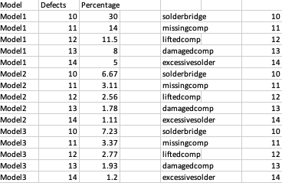
Data used for ANOVA Hypothesis
How many Models?
What is being shown?
Notes:
This is the data that will be used for our ANOVA hypothesis or hypothesis for an Analysis of Variance (ANOVA) test. The image we can see is an excel sheet of production lines, number of defects for the type of defect, percent of how many of those defects have occurred for that defect within that model, and the defect type. This is the data that we will need to figure out what we can do to decrease the defects by 20% and increase our capacity for each line by 20%.

Slide 3
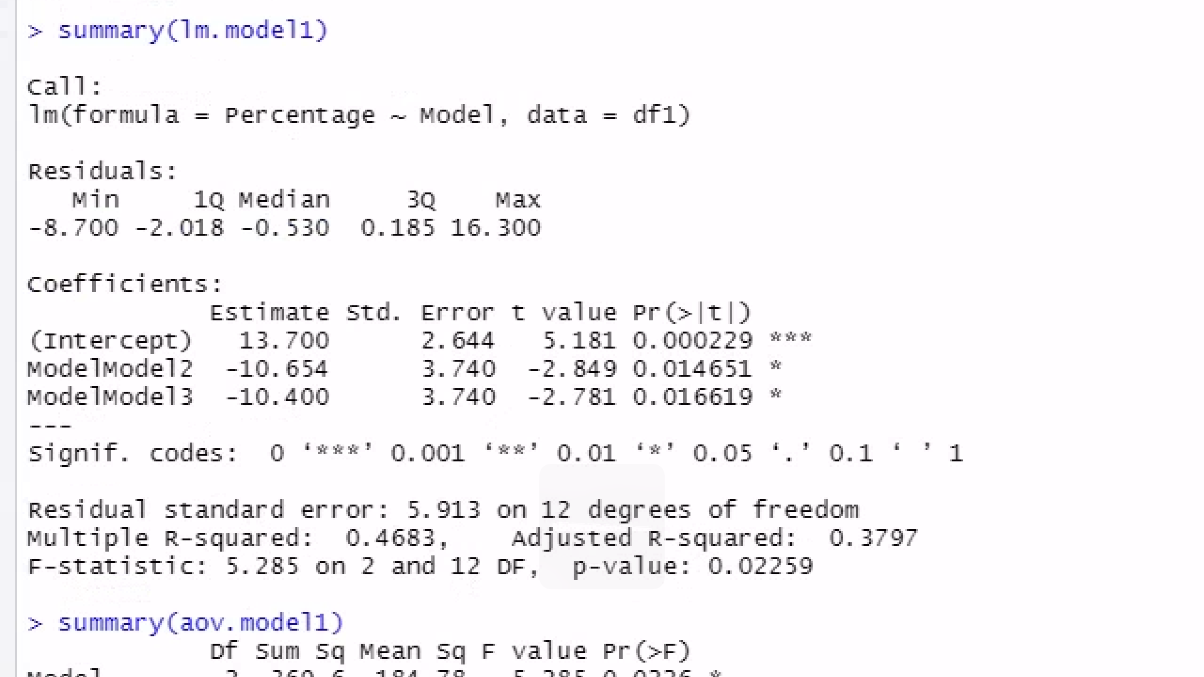
What does our f-statistic tell us?
What does our P-value indicate?
What can be gathered by this OLS test?
Notes:
After examining the f-statistic chart and the info we have on the f-statistic in our OLS test (the image above) we know that our f-statistic 5.285 is greater than the f-statistic on the chart 3.89 which tells us that we can reject the null hypothesis stating that there is no significant for one of the models with the defect. As we can also see from our p-value at the end of each of the coefficients from the image are all less than 0.05 which means that we can reject the null hypothesis for each of our values as well. From this OLS test we gather that at least one production line is significantly struggling more than the other 2.

Slide 4

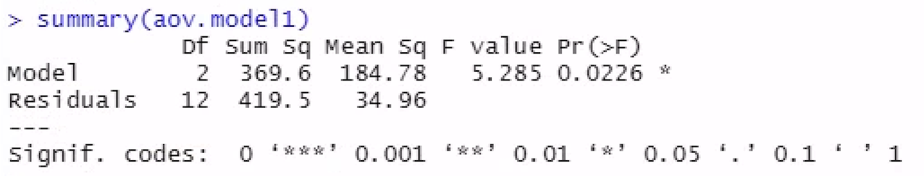
What does the P-value say about our data?
Notes:
As we can see there isn’t much to report on this test other than the p-value which is less than the significance level of 0.05 which means that there is a model or production line that is significantly different than the other 2 models or lines. There is no indication of which model or production line is significantly different or whether it struggles more or does better than the other models but it does tell us that there is a model that is significantly different.

Slide 5
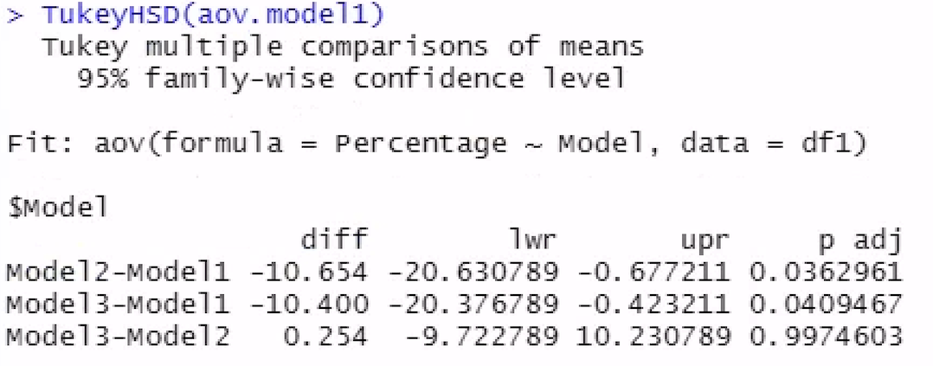
Which model is significantly different than the others?
What does this mean?
Notes:
As we can see from the image above looking at the p-value which is under the p adj column that model one is different from model 2 and model 3 significantly different and model 2 and model 3 are not significantly different from one another. It isn’t easy saying whether model 1 is doing better at avoiding defects or worse than the other two models looking at this particular stat, but we know now that model 1 is the one that needs some change or model 1 is the model we want to use to change how models 2 and 3 run their lines.

Slide 6
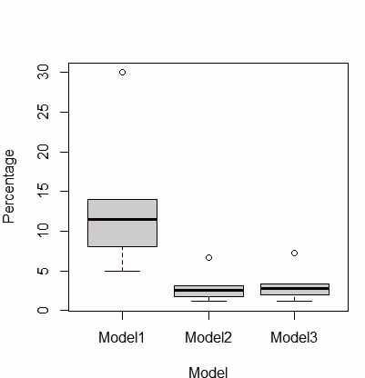
How is Model 1 significantly different?
Is there an obvious difference using the eye test?
Notes:
The box plot makes it easy for us to see how significantly different model 1 is from the other models and whether it has significantly more or less defects occurring in its line that models 2 and 3. Model 1 has significantly more defects than the other 2 lines meaning it is the line that needs the most attention when fixing the defects occurring with a 20% decrease. As we can see even the highest dot for models 2 and 3 doesn’t even hit the 25% quartile for the box plot of model 1. We now know the model that is struggling the most but now its time to do a deep dive and figure out which defects each model is dealing with the most.

Slide 7
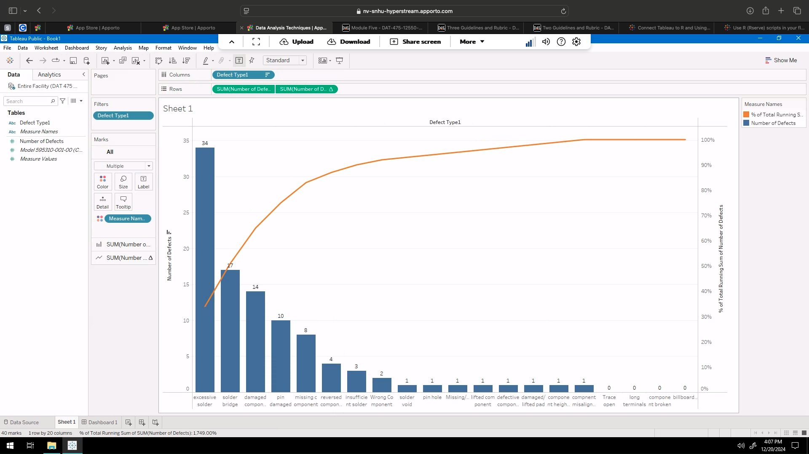
What is the highest defect?
What is the lowest defect?
What does this info mean?
Notes:
From our pareto chart we can see that the defect for model one that is having the biggest impact is excessive solder which we can say needs the most focus when it comes to training the employees to avoid this issue. Those defects that need little to no attention during training are trace open, long terminals, component broken, and billboarding which have no defects on the parts that have been counted for. All of this info helps us fix the biggest issue and helps us waste less time avoiding defects that there are no issues for.

Slide 8
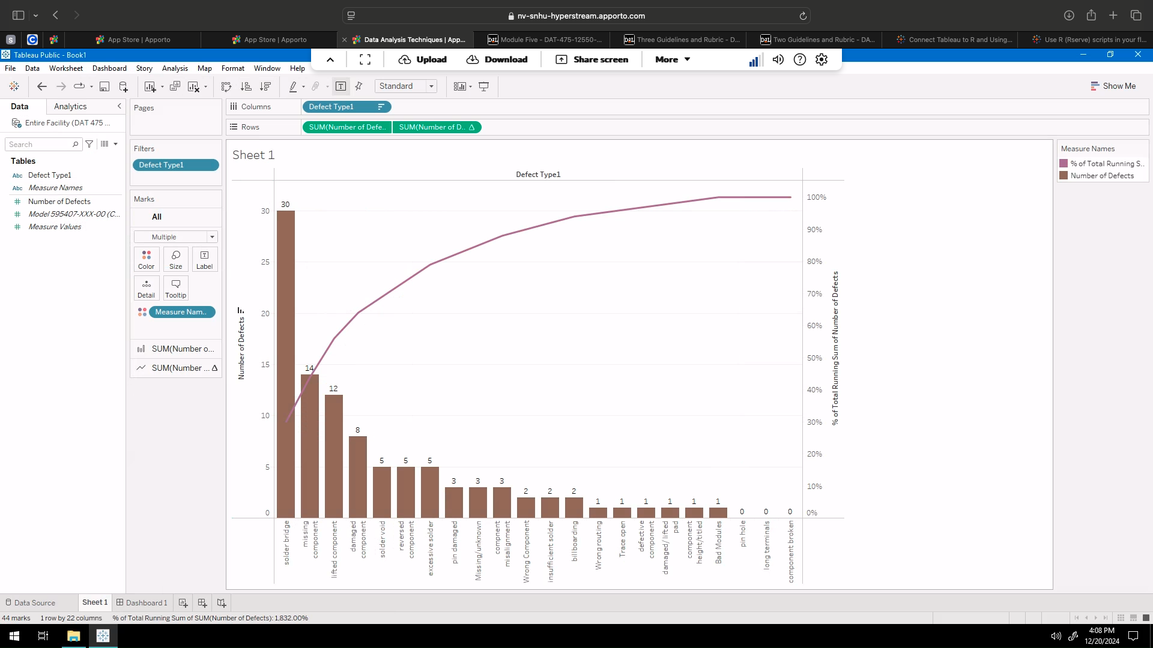
What does Model 2 struggle with the most?
What defects are not occurring with model 2?
Notes:
This pareto chart tells us that the biggest defect for model 2 is solder bridge so when training production line 2 we need to focus more on solder bridge which is at 30 defects. There are three defects that had not been an issue for model 2 which are the pin hole, long terminals, and component broken and we know that component broken and long terminals were also not an issue with model 1. We can make a training plan that focuses a lot on solder bridge and focuses very little or not at all on pin hole, long terminals, and component broken for the model 2 team.

Slide 9
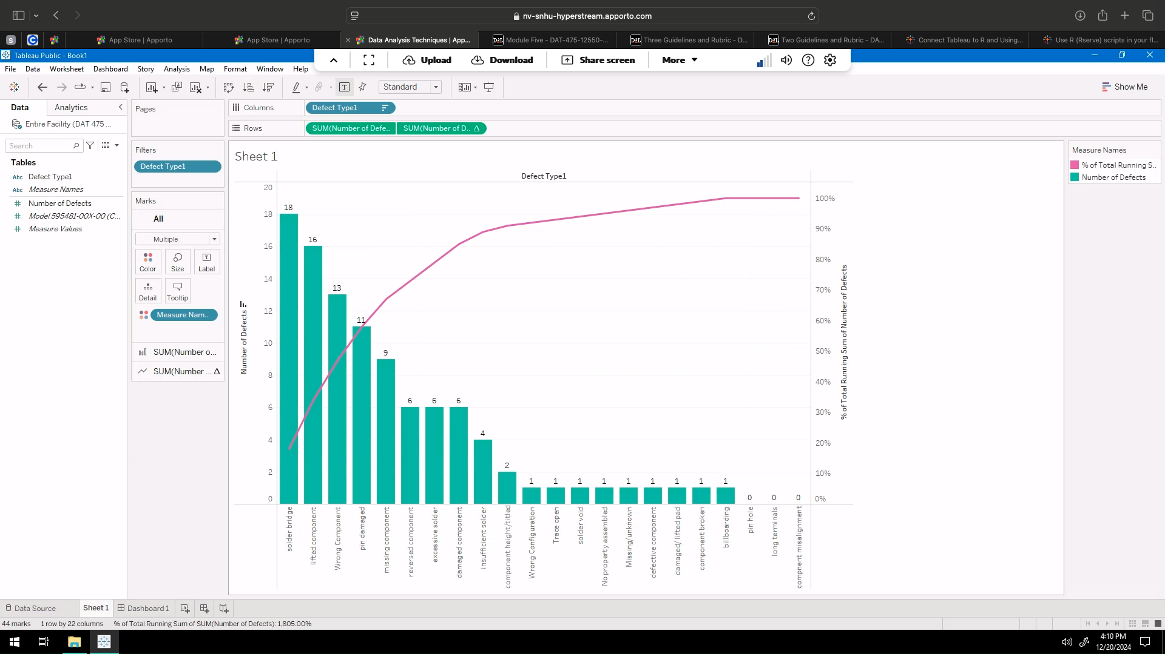
Most defects for Model 3
Least defects for Model 3
Training needed for this line
Notes:
Model 3 has an issue with the solder bridge just like model 2 with 18 defects which I believe is just a coincidence and not something that should be looked further into. The defects that are not an issue for model 3 are pin hole, long terminals and component misalignment meaning that our training for model 3 needs to focus on solder bridge and needs to focus less on pin hole, long terminals, and component misalignment. This training can be just like model 2s training video because the only difference on focuses with model 3 is component misalignment.

Slide 10
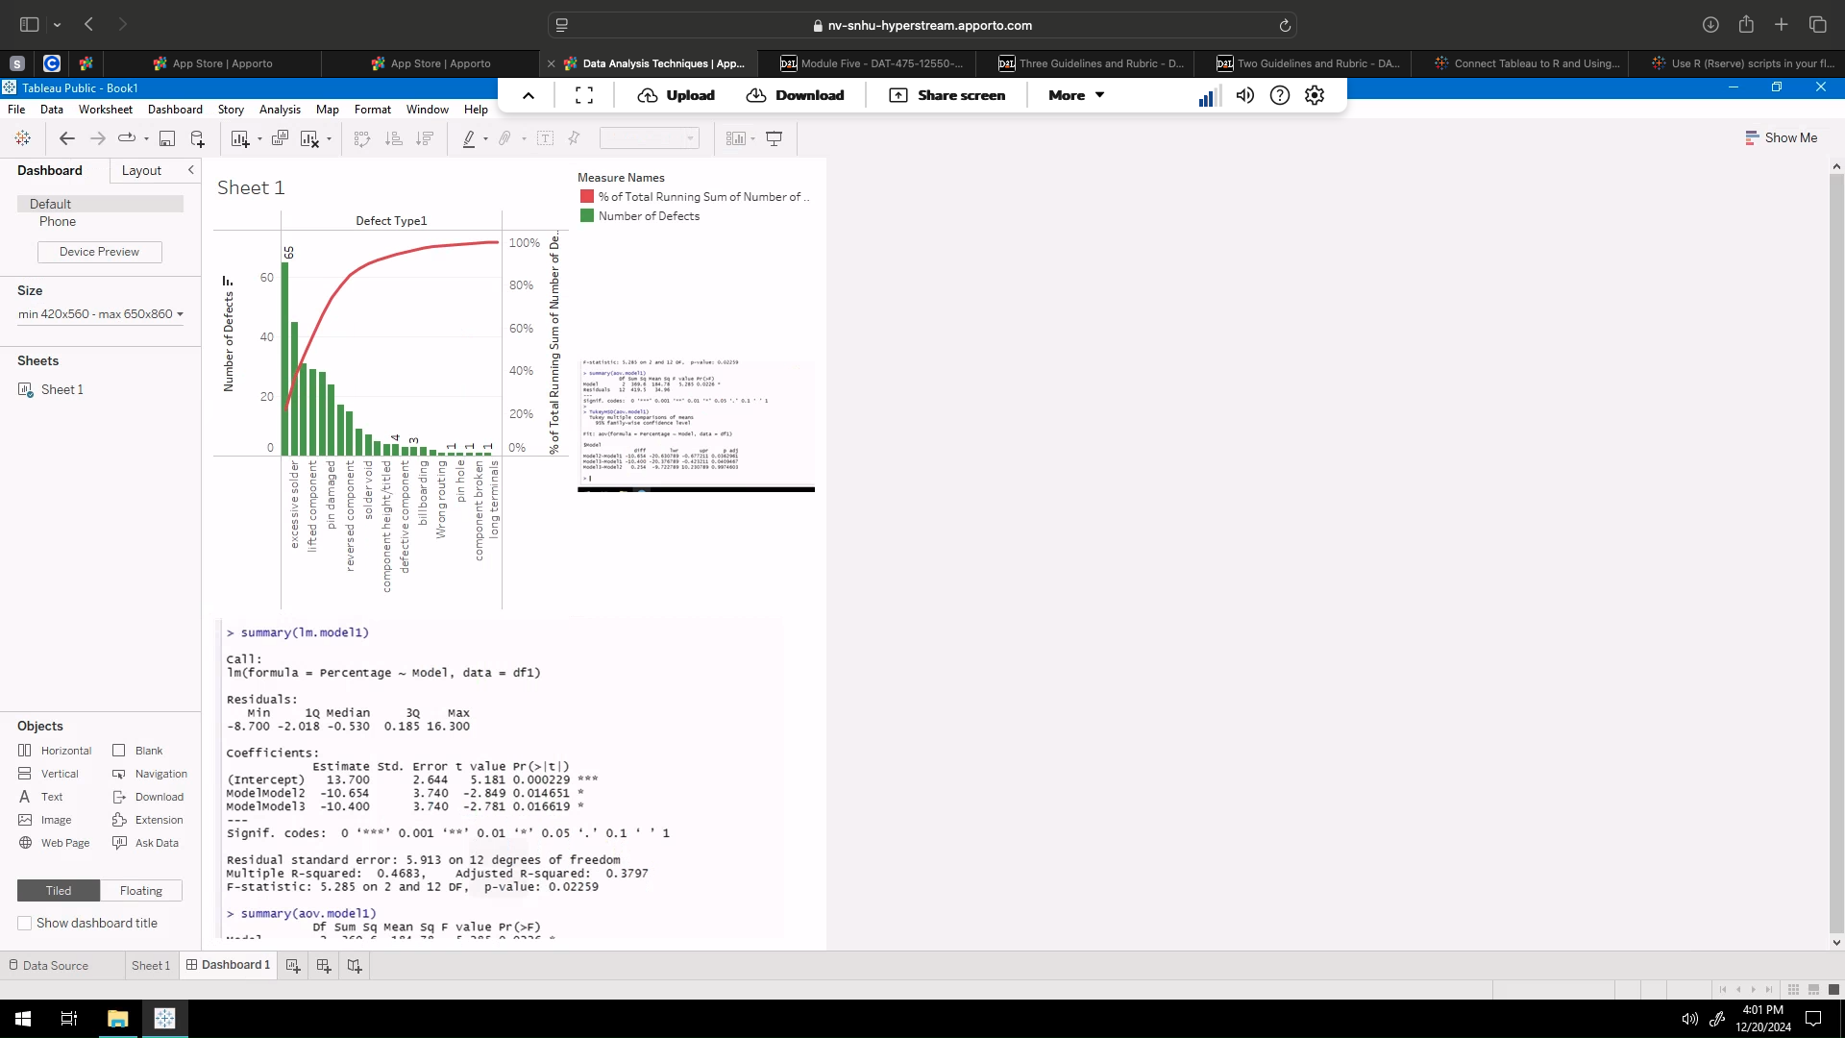
What is the biggest issue of all 3 models?
What is the only defect with no issues for all 3 models?
What does this mean?
Notes:
The biggest issue among the 3 models is solder bridge with 65 defects with the second biggest issue being excessive solder at 45 defects. The only defect between the 3 models that has not been an issue at all is the long terminals which needs no focus when we start training on fixing the issues we have been having. This information tells us what we need to focus on with training and what can be forgotten within training to help get us decrease defects by 20%.

Slide 11
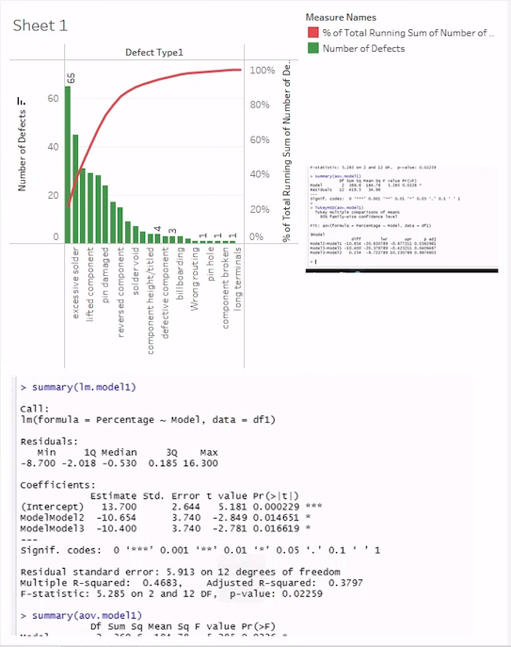
A closer look at our dashboard
Notes:
As we can see this pareto chart was combined with our ANOVA hypothesis testing that we saw earlier in this presentation. Once we are able to decrease our defects by 20%, I believe we can start to increase the capacity by 20% and maybe increase the number of workers at each model to improve on productivity along with decreasing on scrap parts.

Slide 12
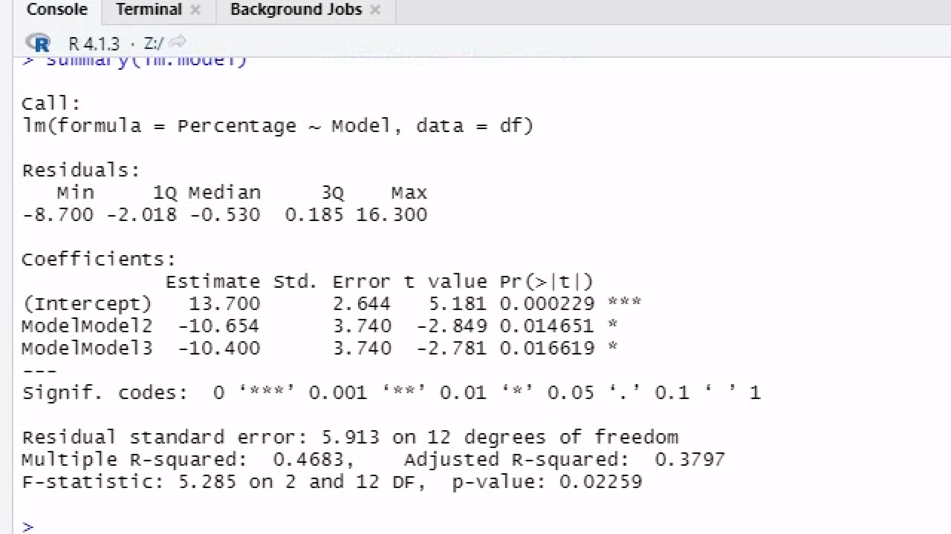
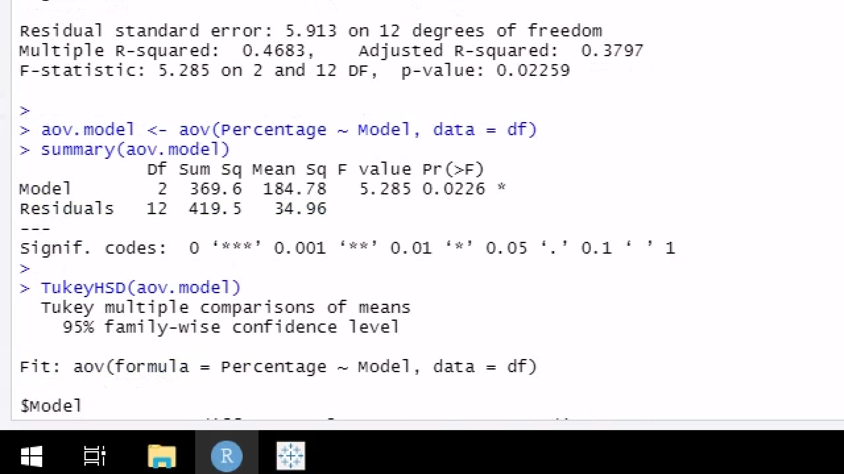
Notes:
Here we see a previous test that was done on our model showing us very similar values as the one we have been viewing within this presentation. It is obvious from both test that we were able to reject the null hypothesis and with both test we know that model 1 is significantly different than models 2 and 3. This tells us that we may need to do more on hands training with model 1 to ensure that our employees that work on model 1 can decrease the amount of defect they are producing.

Slide 13

Thank You For listening!

